Slide 1
Seminar 1

Slide 2

Shell
A shell is a program that lets users interact with the operating system by typing commands.
Windows:
Default terminal – don’t recommend
PowerShell
WSL/bash – best for UNIX shell like experience
Linux (MacOS):
Bash (default on Linux)
Zsh (default on Mac OS)

Slide 3
Bash simple command syntax
command [ -short ] [ --long-options ] [ --long-options[=] <option value> ] [arguments like files, directories, patterns]
-short – short name for boolean (true/false) flags (e.g., -i) --long-options – full name for boolean flags (e.g., --recursive) or options that accept a value (e.g., --color=always or
--binary-files text) Example: grep -i --color=always --exclude="*.log" \ --recursive --binary-files text "critical failure message" /var/log /etc/configs

Slide 4
List of useful commands
File & Directory Management
ls — list files and directories
cd <path> — change directory
pwd — print current directory
mkdir <name> — create a directory
rm <file> — remove a file (-r flag for recursive)
File Operations
touch <file> — create an empty file
cp <src> <dst> — copy file or directory
mv <src> <dst> — move or rename
cat <file> — display in stdout file content
head, tail <file> — show first / last lines
Search & Filter
grep "text" <file> — search substring inside files
find <path> -name "*.txt" — search files by templated name
Archives & Downloads etc.
tar -czf archive.tar.gz <dir> — create compressed archive
wget <URL> — download from the internet
clear — clear terminal
exit — exit the shell
echo — print something to stdout
If If you need to specify the current directory as the path in the command arguments, use ".", if the parent one, then ".."
Tip: Add --help flag after command to see its arguments

Slide 5
Command Data Streams in Bash
Standard Input (stdin)
Source of input (keyboard, file, or another command) Use ”<” for redirecting to command stdin file content
Example: cat < input.txt
Standard Output (stdout)
Where normal output goes (usually the terminal) Use ”>” for redirecting from command stdout to file
Example: ls > files.txt
Standard Error (stderr)
Where error messages are sent
Use “2>” for redirecting from command stderr to file
Example: grep "x" missingfile 2> error.log

Slide 6
Bash command operators
; — run commands in sequence, regardless of success
&& — run next only if previous succeeds
|| — run next only if previous fails
& — run command in background
| — redirect stdout of one command to stdin of another
Examples: — ls . > out.txt && cat out.txt; echo “This text will always be displayed.”
— echo "You won’t see this message, it will be passed to a grep." | grep -b -o "written" > out.txt (here we get the position of the first encounter of the substring "written" in the text) — grep -r ”text” / > out.txt & echo “This message will be displayed without waiting for the grep to finish.”

Slide 7
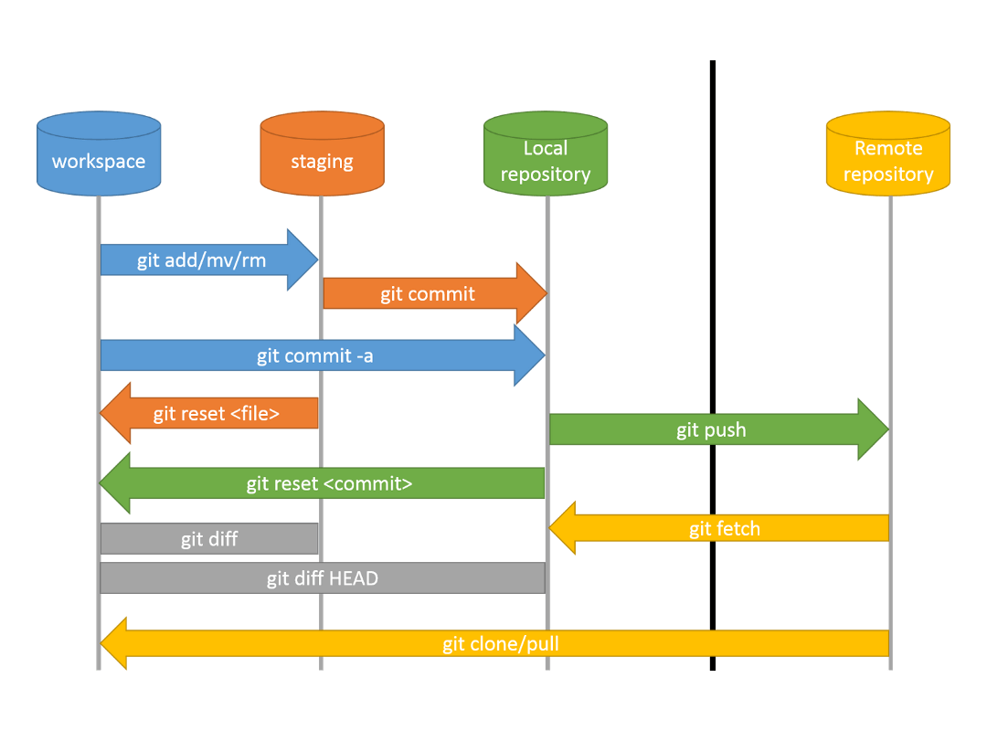
Version control (Git)
Working directory (Working tree)
It is outside the version control system
Index (Staging area)
Changes that are monitored by the version control system Will be included in the next commit
Local Repository (Changes history) The history of changes saved in the local database

Slide 8
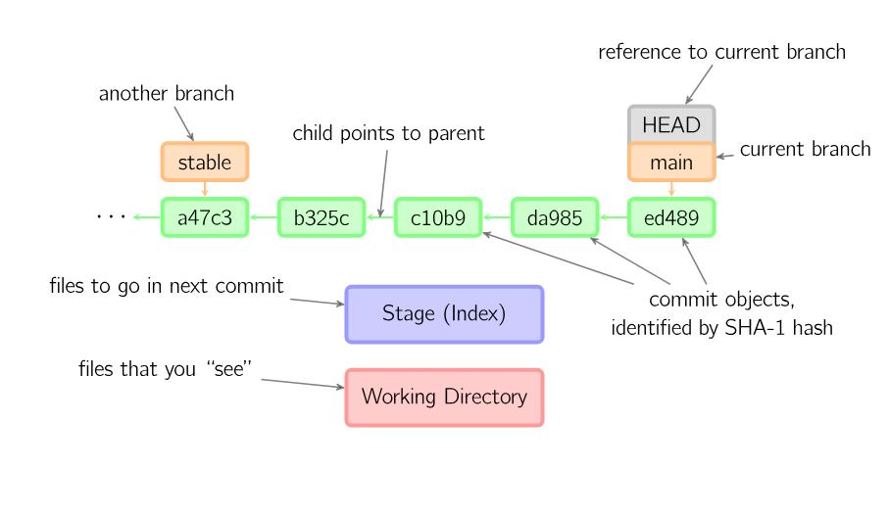
How git works inside?

Slide 9
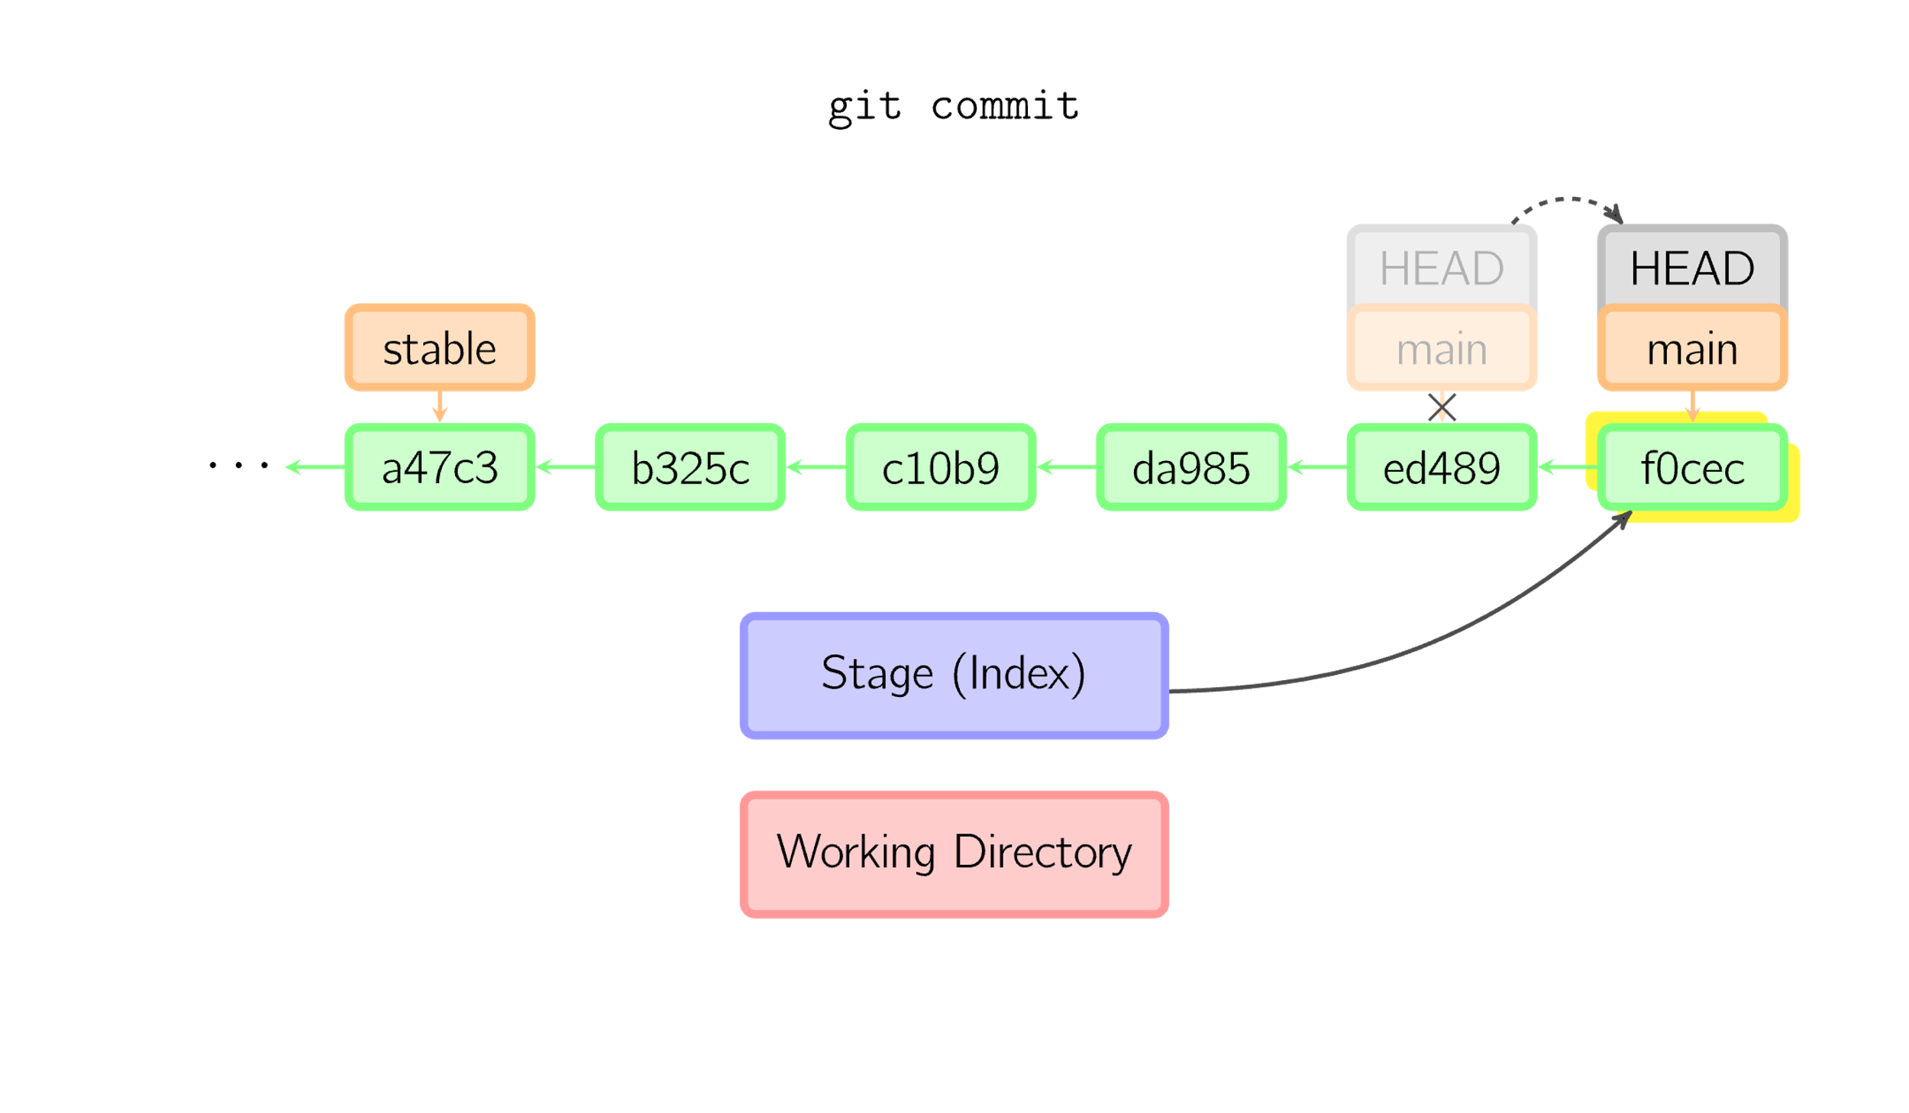
Git add and commit
git add some_file.txt – move file to staging area git commit -m "The first commit" – move files in staging area to the changes history

Slide 10
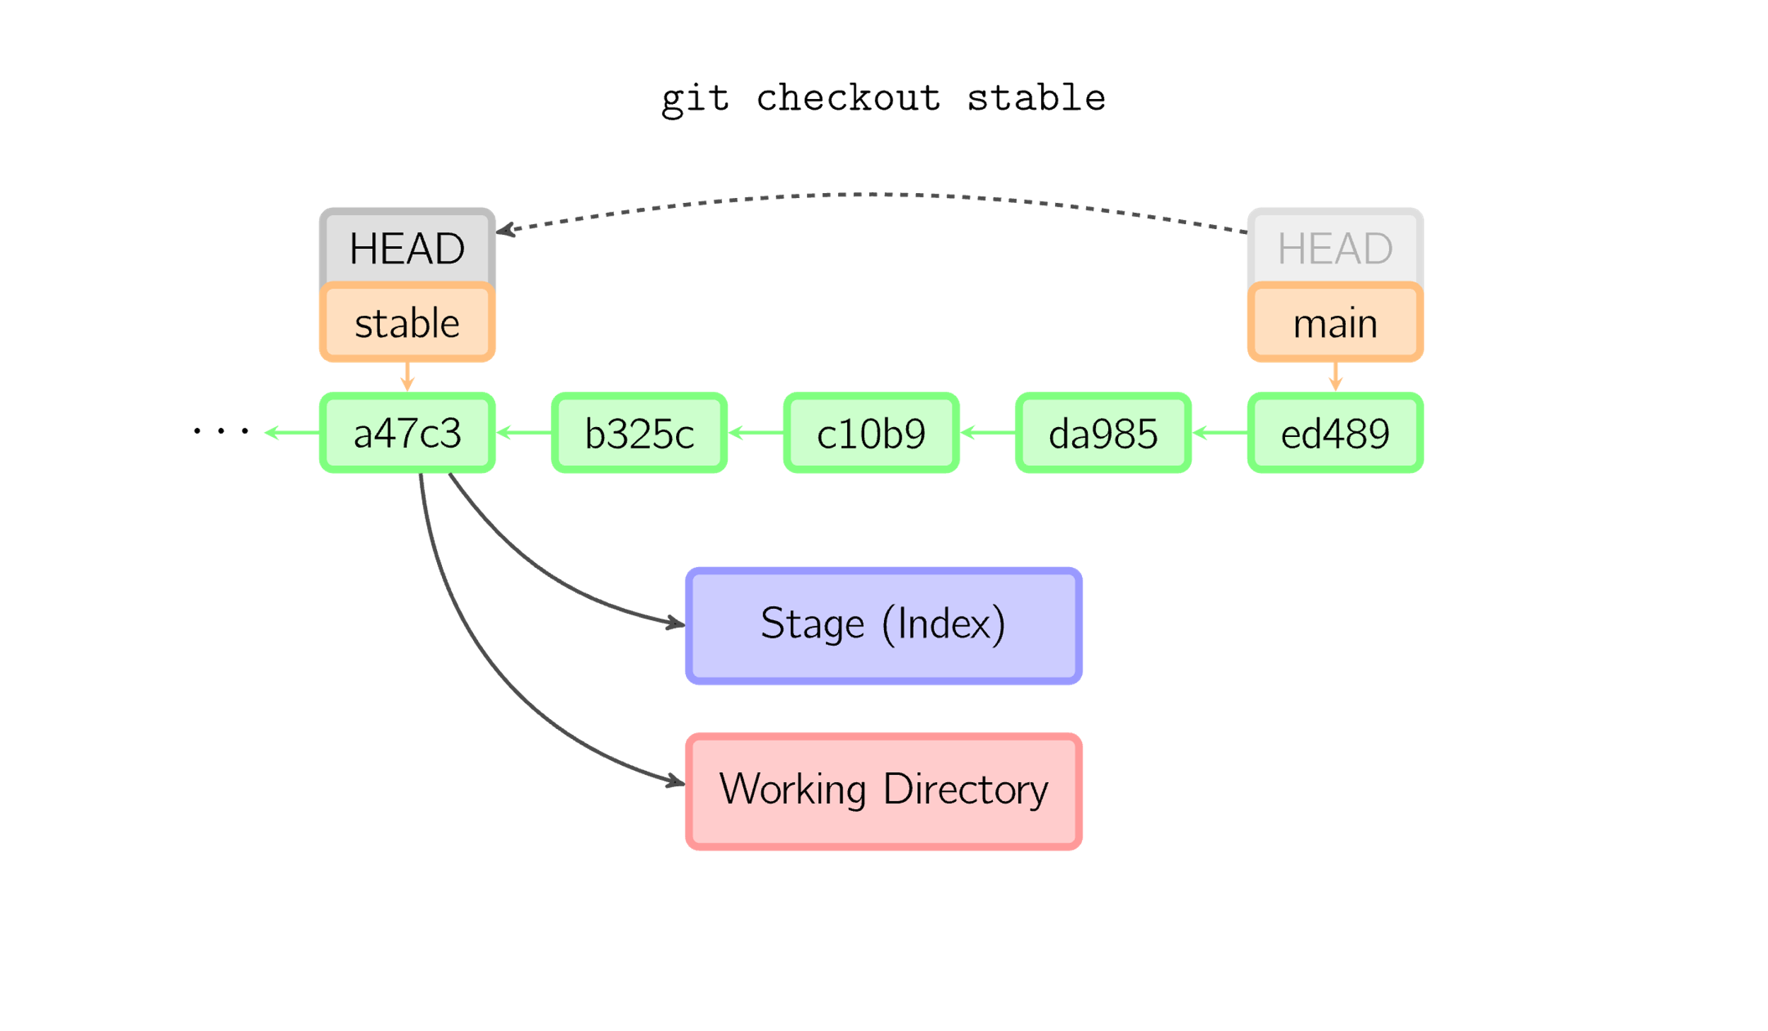
Git checkout
git checkout <commit_id> – move pointer HEAD to another commit in tree and new branches creation Example:
git checkout stable (will switch to another branch (create if not exist)) git checkout a47c3 (will move HEAD of current branch to this commit)

Slide 11
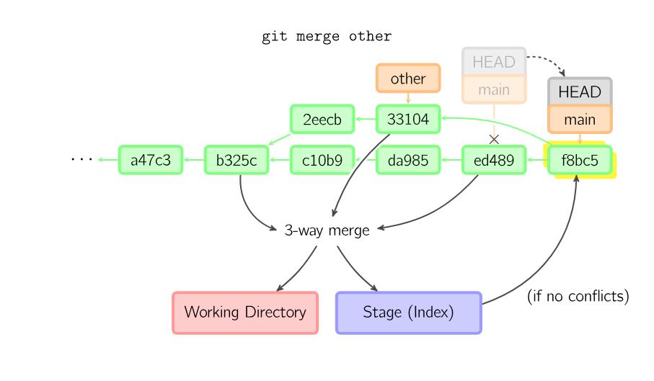
Git merge
git merge <commit_left> <commit_right> – merges two commits and creates new one

Slide 12
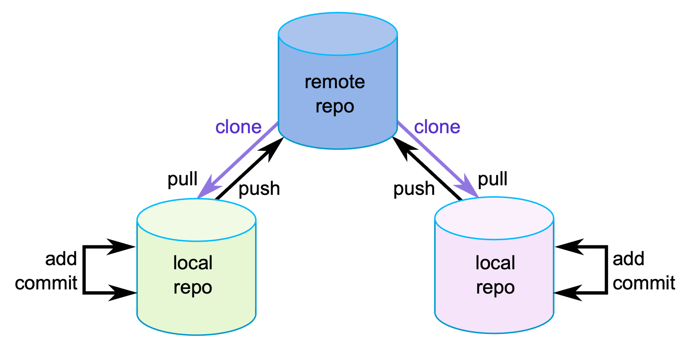
Git push and fetch and remote repo
git push – upload local commits to the remote repo. git fetch– Download latest changes from remote without merging. git pull – [git fetch + git merge] in one command git clone – copy a remote repo to your local machine (creates new local repo)

